Slide 1
Capstone Project - The Battle of the Neighborhoods (Week 2)
Applied Data Science Capstone by IBM/Coursera
Harrison Osuorji

Slide 2
Table of contents
Introduction: Business Problem
Data
Methodology
Analysis
Results and Discussion
Conclusion

Slide 3
Introduction: Business Problem
New York City revolves around coffee. Considering there are 3,389 coffee shops in NYC. New York was one of the largest coffee roasting centers in the United States. More recently, mobile startup MassiveHealth found that New Yorkers drink 6.7 times the amount of coffee consumed by the average denizen of any other US city. And because New York loves Coffee so much, this makes it one of the best place to open a coffee shop.
We want to open a coffee shop in the New York City New York. i want to see what area has the most foot tracffic and to see if my coffee business will be profitable

Slide 4
Data
Based on definition of our problem, factors that will influence our decission are:
number of existing coffee shot in the neighborhood (any type of Coffee shop)
number of and distance to Coffee Shops in the neighborhood, if any
distance of neighborhood from city center
We decided to use regularly spaced grid of locations, centered around city center, to define our neighborhoods.
Following data sources will be needed to extract/generate the required information:
centers of candidate areas will be generated algorithmically and approximate addresses of centers of those areas will be obtained using Google Maps API reverse geocoding
number of Coffee Shop and their type and location in every neighborhood will be obtained using Foursquare API
we will also going to Run k-means to cluster the neighborhood into 5 clusters

Slide 5
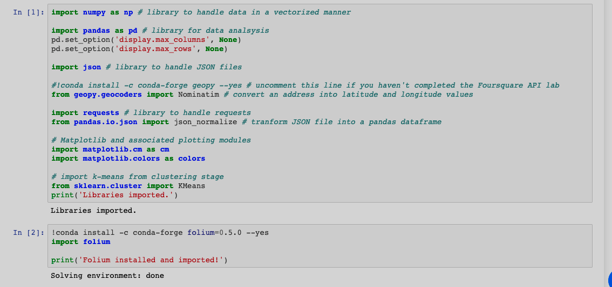
Neighborhood Candidates
Let's create latitude & longitude coordinates for centroids of our candidate neighborhoods. We will create a grid of cells covering our area of interest which is aprox. 12x12 killometers centered around New York City center.
Let's import all the Librarys we will need.

Slide 6
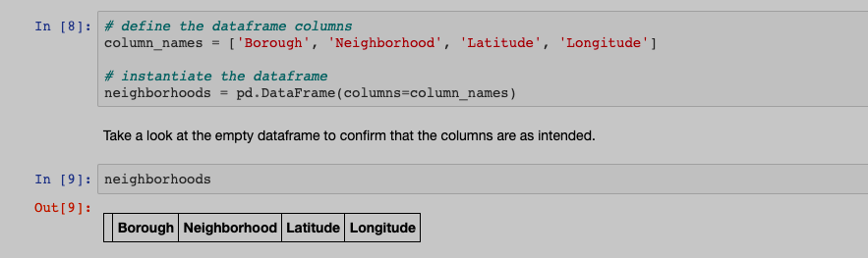
Tranform the data into a pandas dataframe
The next task is essentially transforming this data of nested Python dictionaries into a pandas dataframe. So let's start by creating an empty dataframe.

Slide 7
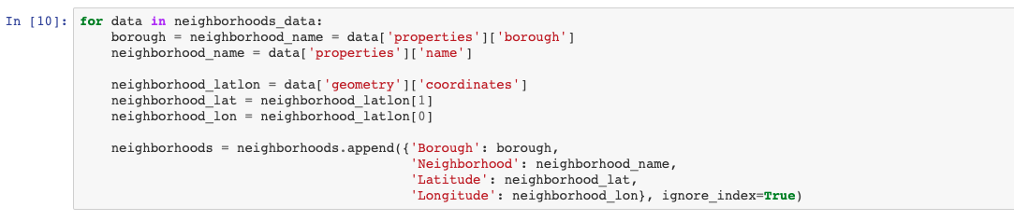
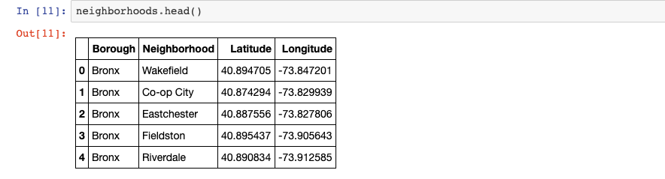
Then let's loop through the data and fill the dataframe one row at a time.
Quickly examine the resulting dataframe.

Slide 8
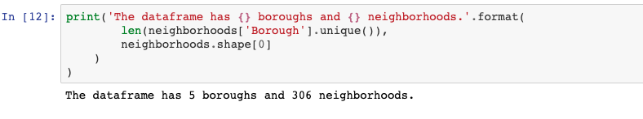
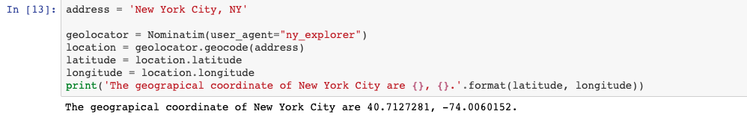
And make sure that the dataset has all 5 boroughs and 306 neighborhoods.
Use geopy library to get the latitude and longitude values of New York City
In order to define an instance of the geocoder, we need to define a user_agent. We will name our agent ny_explorer, as shown below.

Slide 9
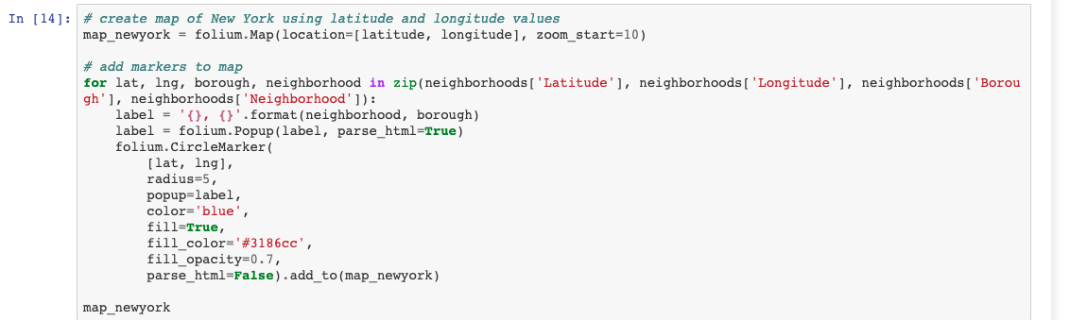
Create a map of New York with neighborhoods superimposed on top.

Slide 10
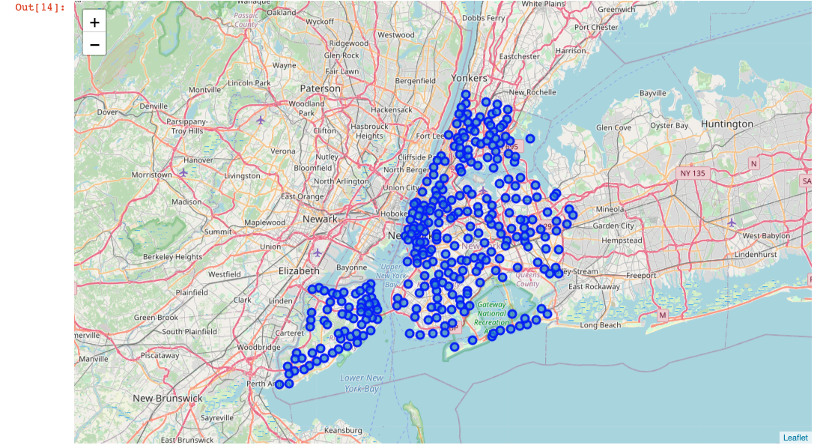

Slide 11
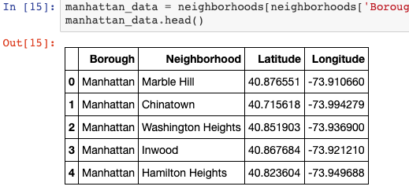
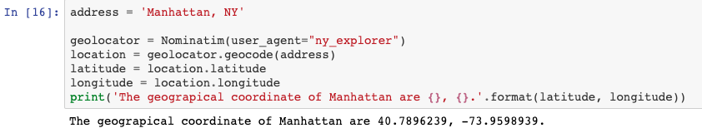
However, for illustration purposes, let's simplify the above map and segment and cluster only the neighborhoods in Manhattan. So let's slice the original dataframe and create a new dataframe of the Manhattan data.
Let's get the geographical coordinates of Manhattan.

Slide 12
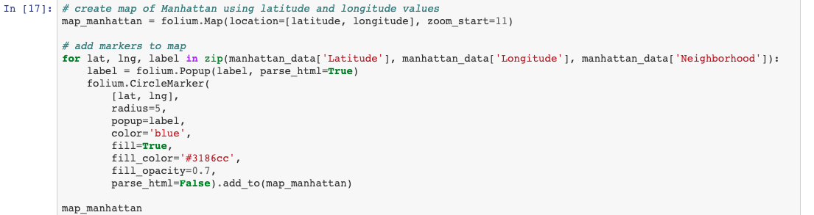
As we did with all of New York City, let's visualize Manhattan the neighborhoods in it.

Slide 13
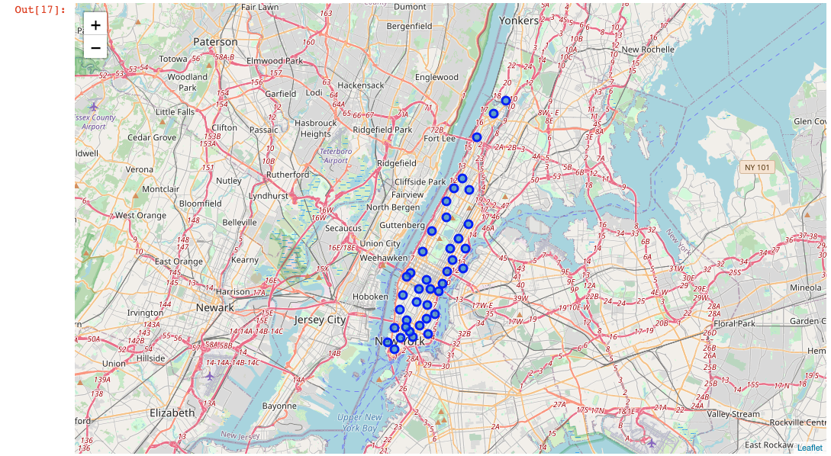

Slide 14
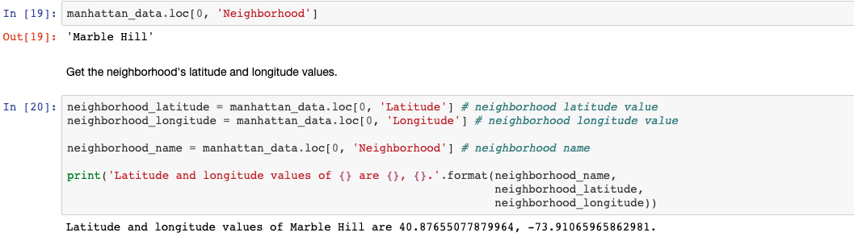
Next, we are going to start utilizing the Foursquare API to explore the neighborhoods and segment them.
Define Foursquare Credentials and Version
Let's explore the first neighborhood in our dataframe
Get the neighborhood's name.

Slide 15
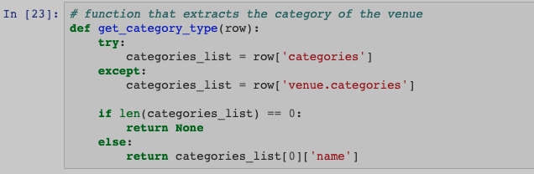
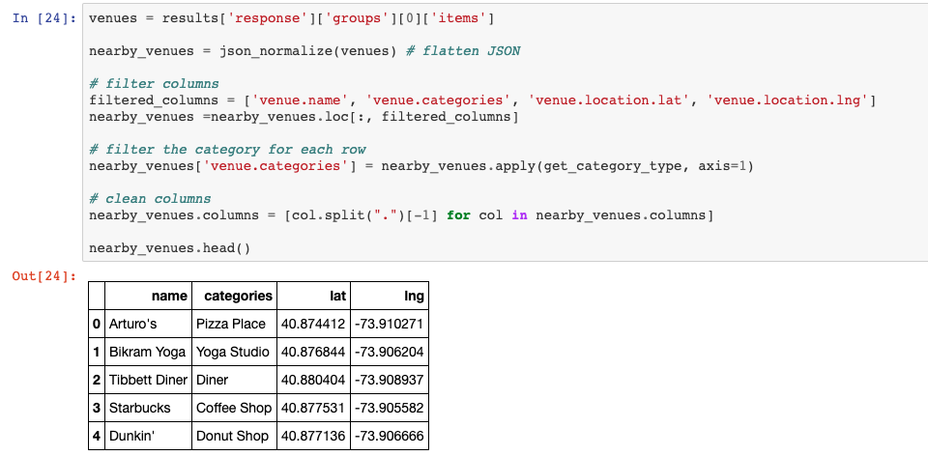
From the Foursquare lab in the previous module, we know that all the information is in the items key. Before we proceed, let's borrow the get_category_type function from the Foursquare lab.
Now we are ready to clean the json and structure it into a pandas dataframe.

Slide 16
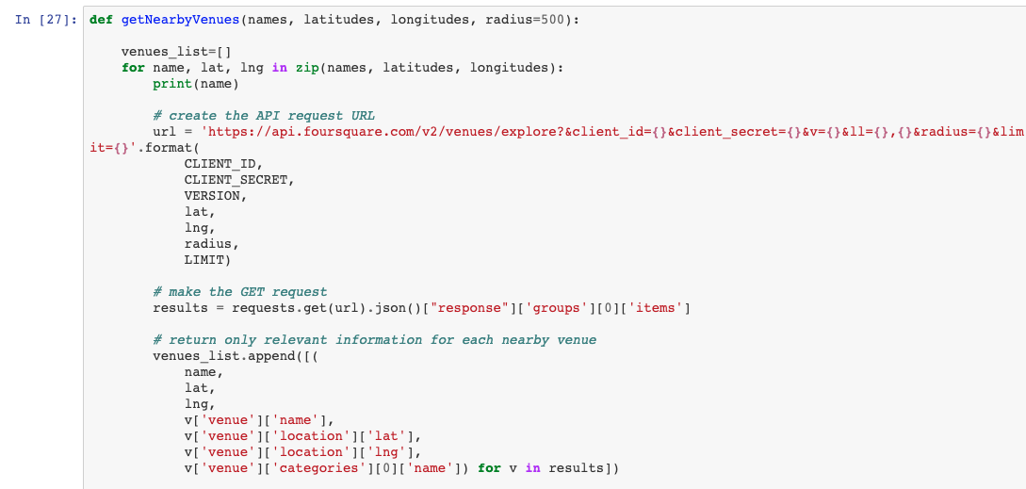
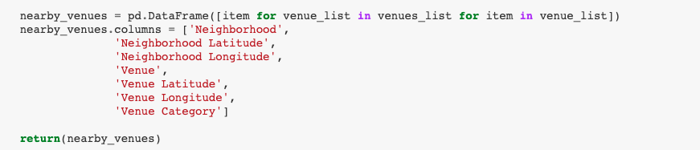
Explore Neighborhoods in Manhattan
Let's create a function to repeat the same process to all the neighborhoods in Manhattan

Slide 17
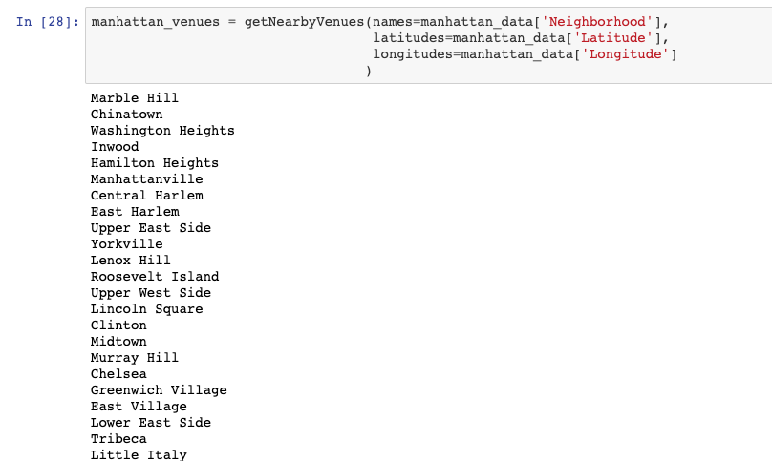
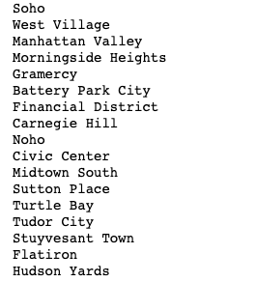
Now write the code to run the above function on each neighborhood and create a new dataframe called manhattan_venues
In [28]:

Slide 18
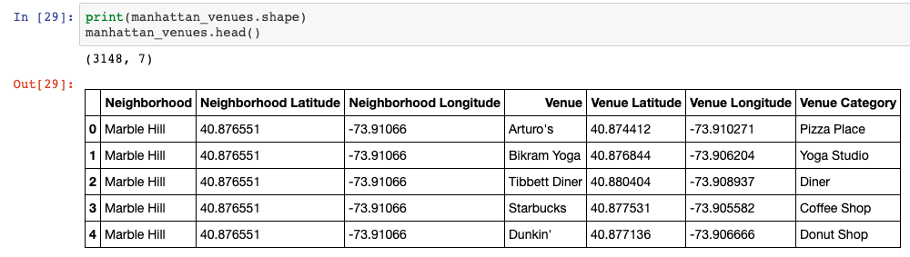
Let's check the size of the resulting dataframe

Slide 19
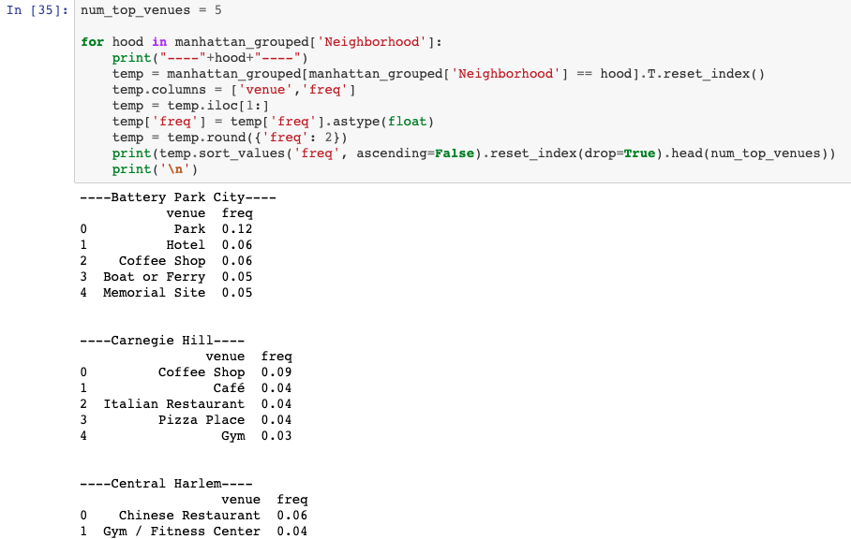
Let's print each neighborhood along with the top 5 most common venues

Slide 20
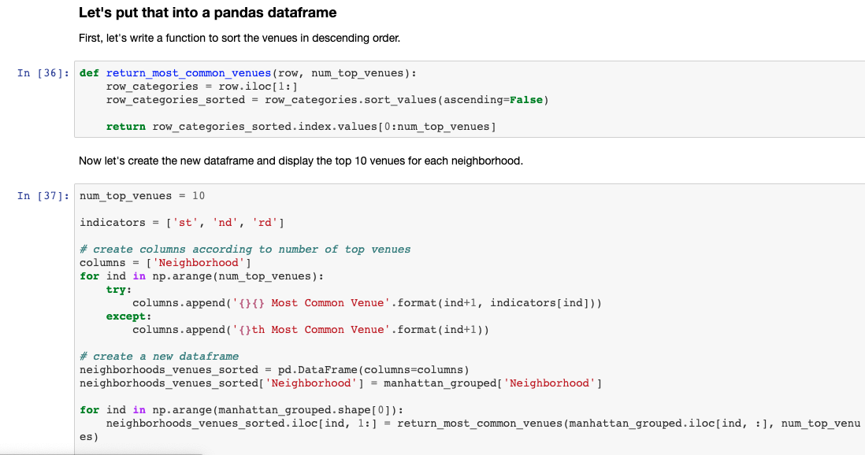

Slide 22
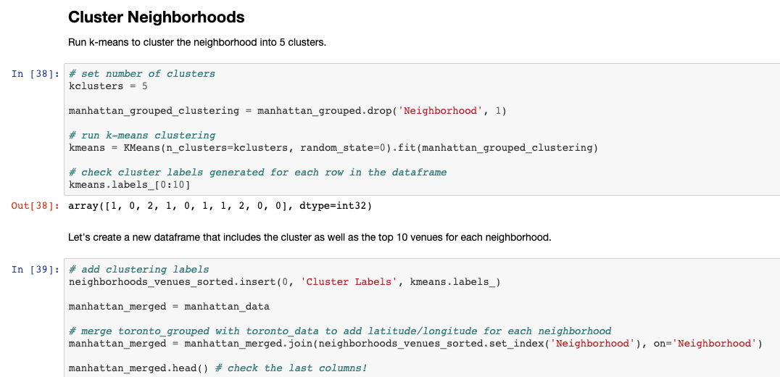

Slide 23
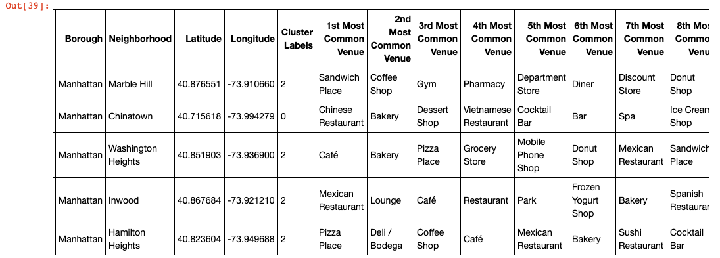

Slide 24
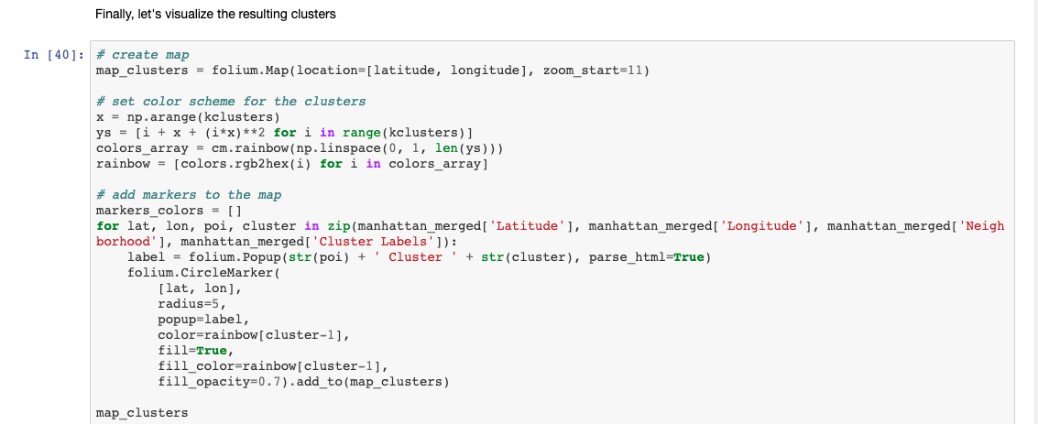

Slide 25
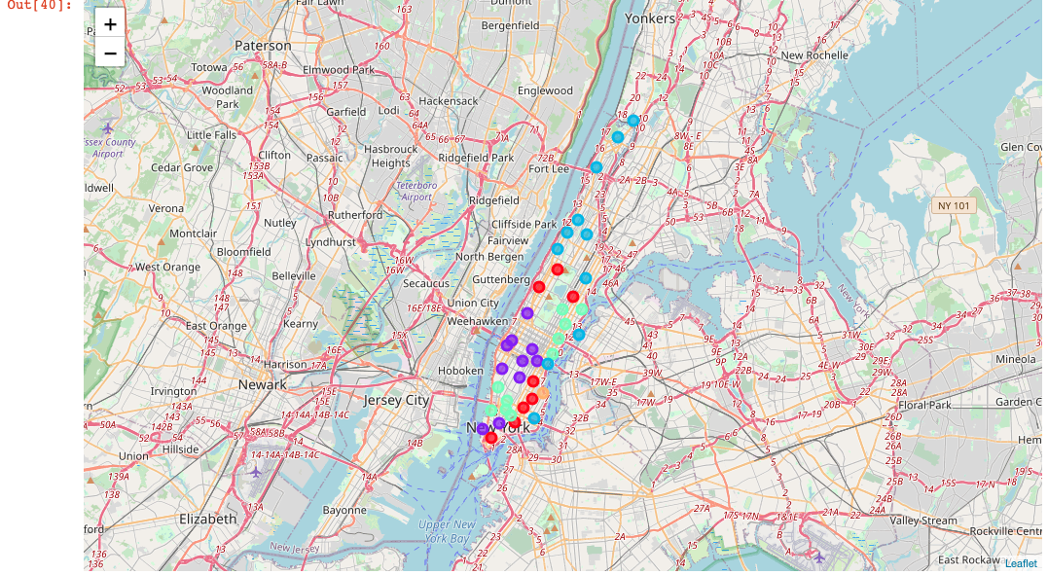

Slide 26
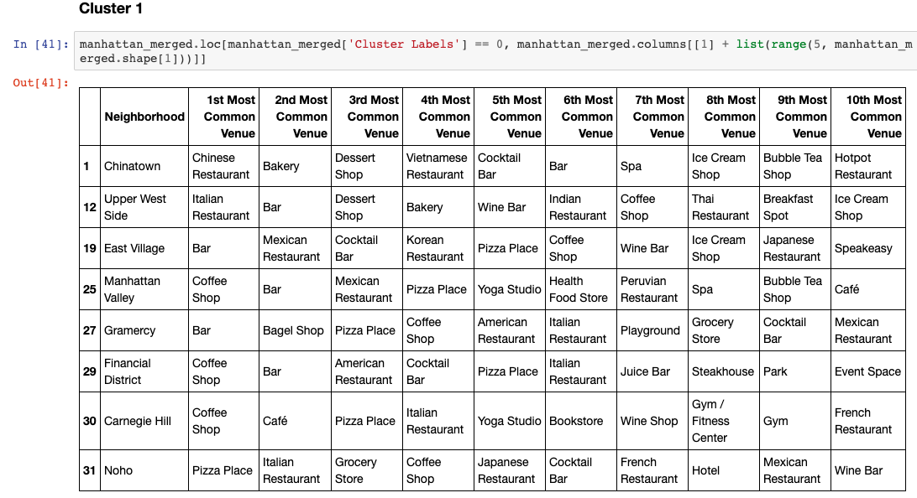
Examine Clusters
Now, you can examine each cluster and determine the discriminating venue categories that distinguish each cluster. Based on the defining categories, you can then assign a name to each cluster. I will leave this exercise to you.

Slide 27
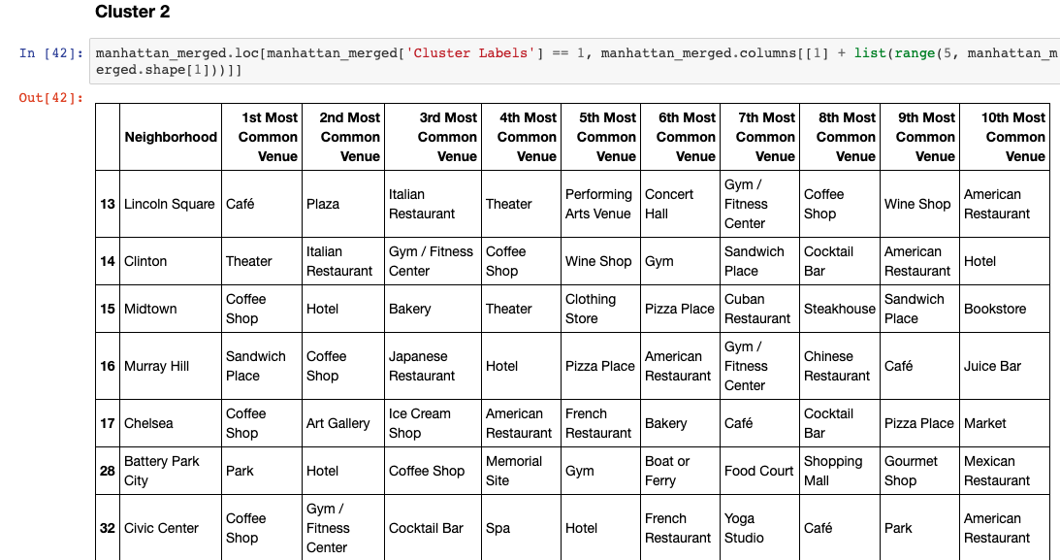
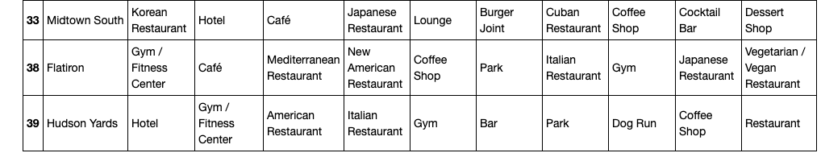

Slide 28
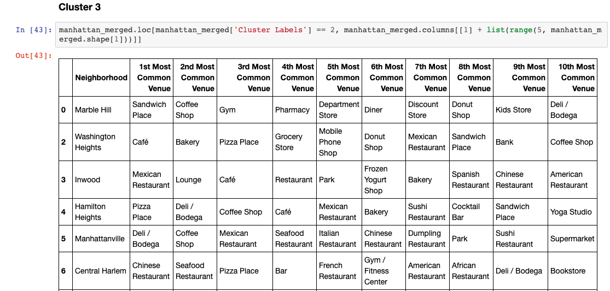
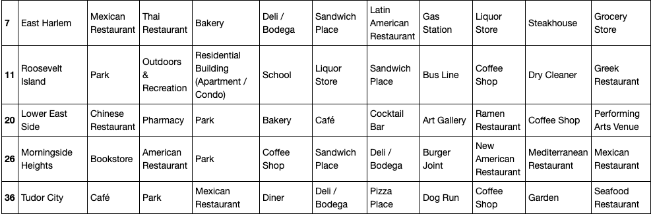

Slide 29
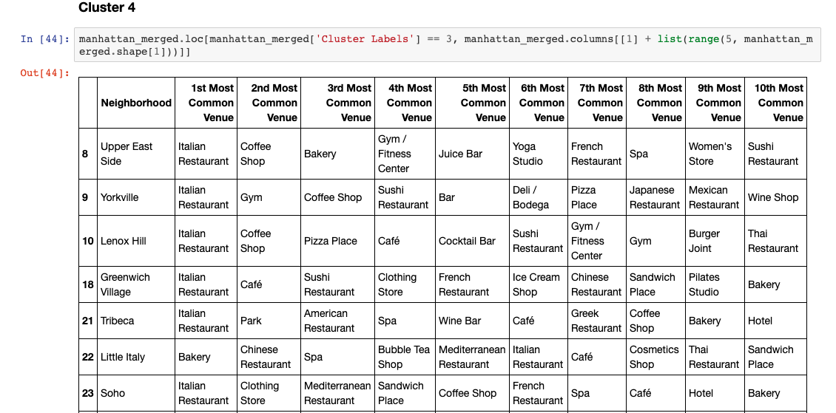
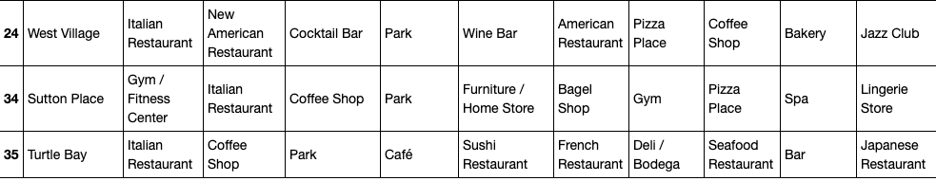

Slide 30
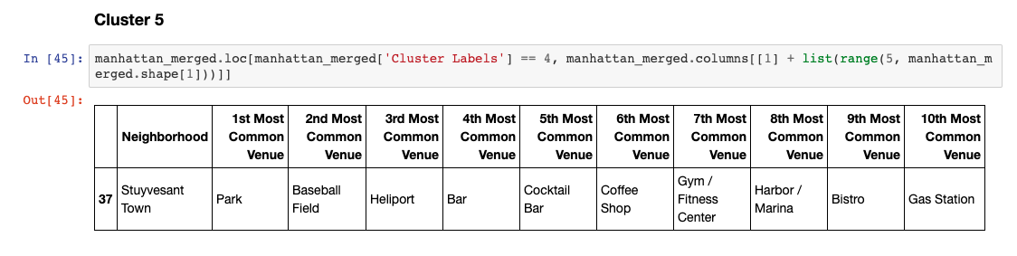

Slide 31
Results and Discussion
Beased on our reseach, we could see that New York City have lots of coffee shop. As a matter of fact their are over 3,389 coffee shops in NYC. After looking at all the factors, we beleive NYC is the perfect location for a new coffee shop. We took a look at all the Borough in NYC and figured out where is the best place for a new coffee shop. We look at foot tracffic, other kinds of food stores around the real. After all the research, we believe Manhattan is the best location,
We than broke Manhattan down to Neighborhood to see where is the best place for a new coffee shop. we found out that Marble Hill is the best location for a new coffee shop. accounding to foursqure data, coffee shop is the 2nd most popular venue in Marble Hill next to sandwhich store. We also ran k-means to cluster the neighborhood into 5 clusters and in the secound cluster, we could clearly see that coffee shop is very popular.

Slide 32
Conclusion
Why coffee shop
Coffee shops are undoubtedly a small piece of the much larger puzzle that is contemporary urban living; yet their importance should not be underestimated. From their influence on the enlightenment to their ever-evolving status. Openning a coffee shop is my own small way of contributing to my community. Coffee brings poeple together and i love bringing people together. If i could bring more people together, i believe i have done my part to help the human race along.

